Slide 1
IS-75: Military Resources in Emergency Management

Slide 2
Class Introductions
Name
Position/title
Emergency response experience
Expectations
Notes:
2

Slide 3
Course Objectives
At the end of this course, students should be able to:
Describe the command relationships of local, tribal, state, and Federal incident response assets, including state and Federal military resources supporting civilian authorities
Describe the types of military response available to states
Describe the representatives, authorities, and assignments involved in a Federal military forces disaster response
Identify the characteristics of the various military resources and their associated capabilities useful in an emergency response
Describe the process for developing a Military Support Emergency Support Function (ESF) annex for your jurisdiction
Describe the planning products resulting from the planning process
Notes:
3

Slide 4
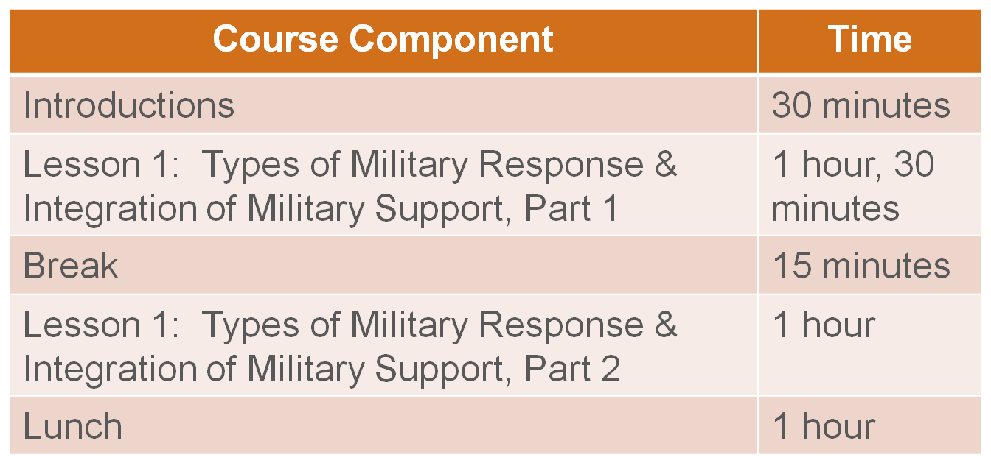
Course Agenda
Notes:
4

Slide 5
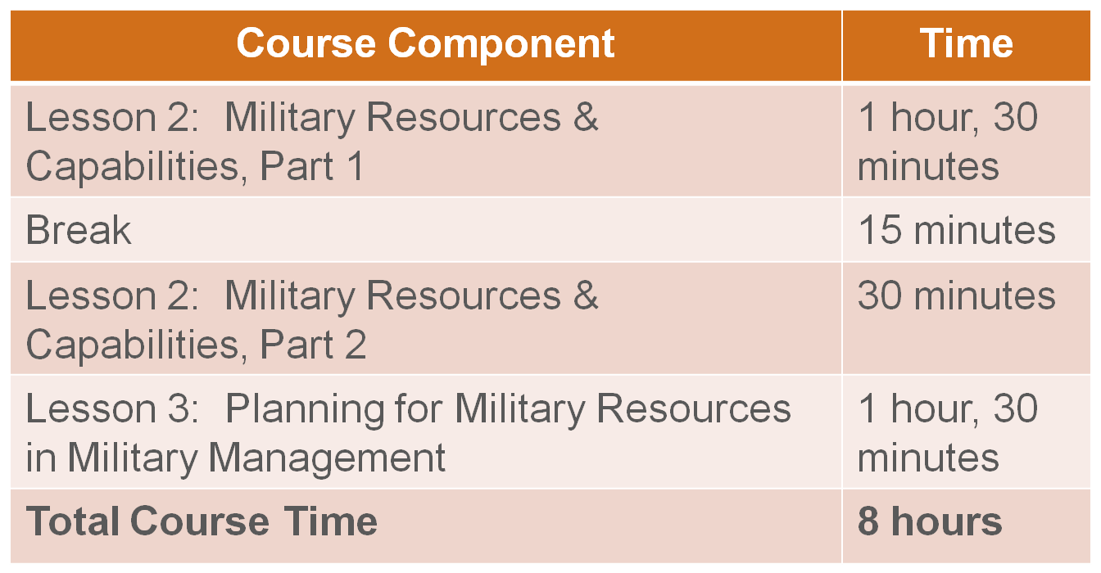
Course Agenda (continued)
Notes:
5

Slide 6
Course Administrative Details
Breaks
Lunch
Emergency exit locations
Restroom locations
Notes:
6

Slide 7
Lesson 1: Types of Military Response and Integration of Military Support

Slide 8
Topics Covered
The following topics are covered in this lesson:
Defense Support of Civil Authorities (DSCA)
Levels of Response
Types of Military Response
Representatives in a Federal Response
Tribal Governments in Emergency Response
Authorities for Federal Response
Mission Assignment Process
Pre-Scripted Mission Assignments
Notes:
8

Slide 9
Objectives
After completing this lesson, you will be able to:
Describe the command relationships of local, tribal, state, and Federal incident response assets, including state and Federal military resources supporting civilian authorities
Describe the types of military response available to states
Describe the representatives, authorities, and assignments involved in disaster response by Federal military forces
Notes:
9

Slide 10
Incident Response Process: Overview
Begins with first responders at the local level
Assistance may be needed from regional and/or state response organizations
If escalated to Federal level, DoD forces may support civilian efforts
Military serves a secondary role in supporting disaster incidents
Note: DoD’s primary mission is homeland security and homeland defense .
Notes:
10

Slide 11
Incident Response Process: Overview (continued)
Understand roles and authorities pertaining to Defense Support of Civil Authorities (DSCA)
Build relationships with military resources
Note: In some states, the state emergency management office is part of the state’s Military Department .
Notes:
11

Slide 12
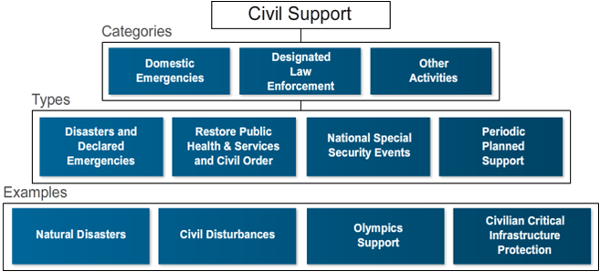
Defense Support of Civil Authorities
Notes:
12

Slide 13
Defense Support of Civil Authorities (continued)
Evaluation criteria:
Legality
Lethality
Risk
Cost
Appropriateness
Readiness
Notes:
13

Slide 14
Levels of Response
Levels of response may include:
Local/Tribal
Regional
State
Federal
Notes:
14

Slide 15
Presidential Actions Related to Federal Response
Other levels of response include:
Major Disaster Declaration
Emergency Declaration
Notes:
15

Slide 16
Types of Military Response
Four main types of military response are available to states:
Mutual Aid Assistance Agreements
Immediate Response Authority (IRA)
Deployment of state military resources (National Guard)
Federal military forces disaster response
Notes:
16

Slide 17
Activity: Types of Military Response
Read the descriptions and examples for your assigned response(s).
Notes:
17

Slide 18
Mutual Aid Assistance Agreements
Regional firefighting mutual aid agreements
DoD Instruction 6055.06
Emergency Management Assistance Compact (EMAC)
Memorandum of Agreement (MOA)/Memorandum of Understanding (MOU)
Notes:
18

Slide 19
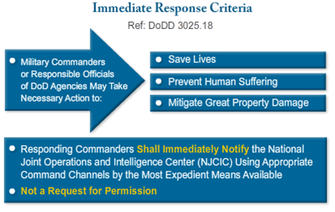
Immediate Response Authority
Notes:
19

Slide 20

Deployment of Military Resources - National Guard
National Guard is first line of military response to most incidents
Forces typically in State Active Duty (SAD) status
Notes:
20

Slide 21
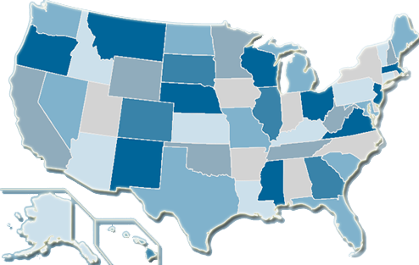
Deployment of Military Resources – State Defense Forces
24 states authorize a state defense force
Strictly state entities, not part of DoD
Authorized to wear military uniform assigned by Adjutant General of the state
Notes:
21

Slide 22

Federal Military Forces Disaster Response
Presidential disaster declaration under the
Stafford Act
Primary Federal agency coordinates with the Defense Coordinating Officer (DCO)
Combatant commander develops concept of operations and support
Secretary of Defense designates supported combatant commander
Notes:
22

Slide 23
Representatives in a Federal Response
SCO - State Coordinating Officer
FCO - Federal Coordinating Officer
DCO - Defense Coordinating Officer
DCE - Defense Coordinating Element
EPLO - Emergency Preparedness Liaison Officer
Notes:
23

Slide 24
Tribal Governments in Emergency Response
Tribal governments are responsible for coordinating resources to address actual or potential incidents
Tribal leaders will seek additional assistance when necessary
Tribal governments can deal directly with the Federal government
Notes:
24

Slide 25
Authorities for Federal Response
Stafford Act
Economy Act
Posse Comitatus Act
Insurrection Act
Notes:
25

Slide 26
Activity: Authorities for Federal Response
Read descriptions and examples for each Act
Complete the activity worksheet
Notes:
26

Slide 27
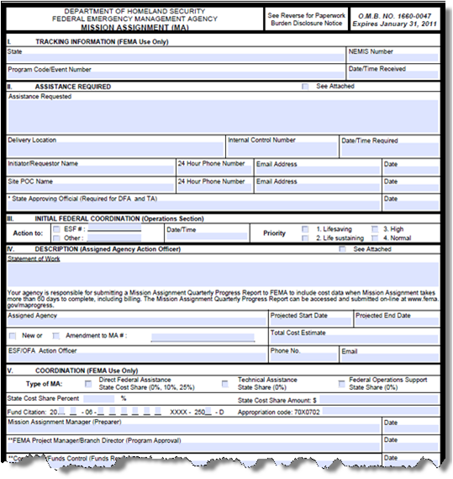
Mission Assignment Process
Notes:
27

Slide 28
Mission Assignment Process
MA - Request assistance from the DoD
Provide reimbursement for direct assistance
DCO determines if requirement can be fulfilled
Notes:
28

Slide 29
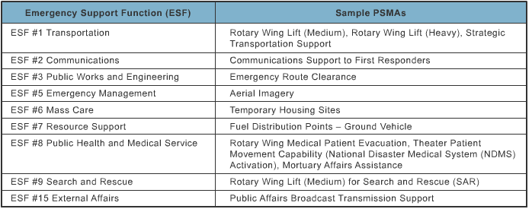
Pre-Scripted Mission Assignments
Facilitates a more rapid coordination process
Specify what type of assistance is required
Identify a statement of work
Provide projected cost
Notes:
29

Slide 30
Pre-Scripted Mission Assignments (continued)
Notes:
30

Slide 31
Activity: Incident Response – Challenge in New Madrid
Review the Challenge in New Madrid scenario
Prepare a brief review to share with the class
Notes:
31

Slide 32
Activity Feedback: Local/Tribal Emergency Manager Group Questions
What types of military response will you request
to assist your population and response agencies, and how will you access each type of military response?
Which type of DoD military responder would be able to conduct law enforcement operations?
Taking CARRL into account, what are some of the specific factors that may determine whether a particular military unit is mobilized to assist in
the response?
Notes:
32

Slide 33
Activity Feedback: State Emergency Manager Group Questions
What types of military response will you request to assist your population and response agencies, and how will you access each type of military response?
Which type of military responder would be able to augment law enforcement operations?
Given the Presidential Disaster Declaration and Stafford Act provisions, what is the process to request Federal (Title 10) military forces for disaster response operations for greater than 72 hours?
Notes:
33

Slide 34
Activity Feedback: State Emergency Manager Group Questions (continued)
Given a Presidential disaster declaration for a Federal response under the provisions of the Stafford Act for a disaster event, must all responding military forces fall under the control of the appointed Defense Coordinating Officer(s)?
Notes:
34

Slide 35
Lesson Summary
Military support must be requested by civilian authorities
Title 10 military forces must be directed by the Secretary of Defense or the President
The military forces’ role is to support other organizations
Notes:
35

Slide 36
Questions?
Notes:
36

Slide 37
Lesson 2: Military Resources and Capabilities

Slide 38
Topics Covered
The following topics are covered in this lesson:
U.S. Military Services
Military Culture
Federal Executive Department Control of the U.S. Military Services
Components of the U.S. Military Services
Other U.S. Uniformed Services
Auxiliaries to the Military Services
Military Capabilities Useful for Emergencies
Incident Support Base (ISB)
Possible Missions
Notes:
38

Slide 39
Objective
After completing this lesson, you will be able to identify the characteristics of the various military resources and their associated capabilities useful in an emergency response.
Notes:
39

Slide 40
U.S. Military Services
United States Army
United States Navy
United States Air Force
United States Marine Corps
United States Coast Guard
Notes:
40

Slide 41
Military Culture
Each of the services has a generalized culture, but there are notable exceptions.
Notes:
41

Slide 42

Activity: Military Culture
Notes:
42

Slide 43
Federal Executive Department Control of the U.S. Military Services
Department of Defense | Department of Homeland Security
Army | Coast Guard
Navy
Air Force
Marines
Notes:
43

Slide 44
U.S. Army Corps of Engineers
Part of the active Army as a major command
Dual - purpose - civil works and military engineering programs
Involved in public works related to the Nation’s waterways and coastal areas
Notes:
44

Slide 45
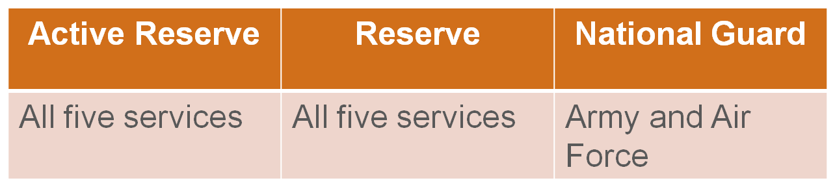
Components of the U.S. Military Services
Notes:
45

Slide 46
Activity: Components of the U.S. Military
Read descriptions and example responses for
each component
Complete the activity worksheet
Notes:
46

Slide 47
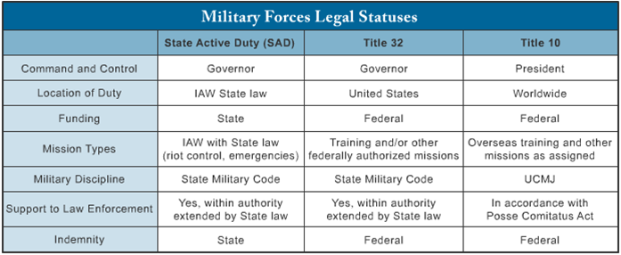
Military Forces Legal Statuses
Notes:
47

Slide 48
Other U.S. Uniformed Services
United States Public Health Service (USPHS) Commissioned Corps
National Oceanographic and Atmospheric Agency (NOAA) Commissioned Corps
Notes:
48

Slide 49
Auxiliaries to the Military Services
Civil Air Patrol (CAP)
U.S. Coast Guard Auxiliary (USCGA)
Military Auxiliary Radio System (MARS)
Notes:
49

Slide 50
Military Capabilities Useful for Emergencies
General
Medical
Special
Notes:
50

Slide 51
Activity: Military Capabilities Useful for Emergencies
Read descriptions and examples for your
assigned capability
Prepare a brief review to share with class
Notes:
51

Slide 52
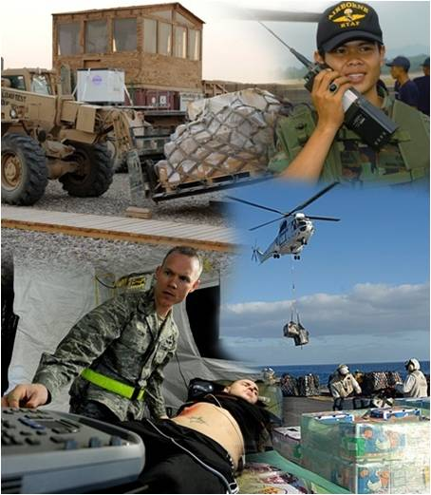
General Capabilities
Heavy Equipment
Airlift
Communications
Medical
Notes:
52

Slide 53
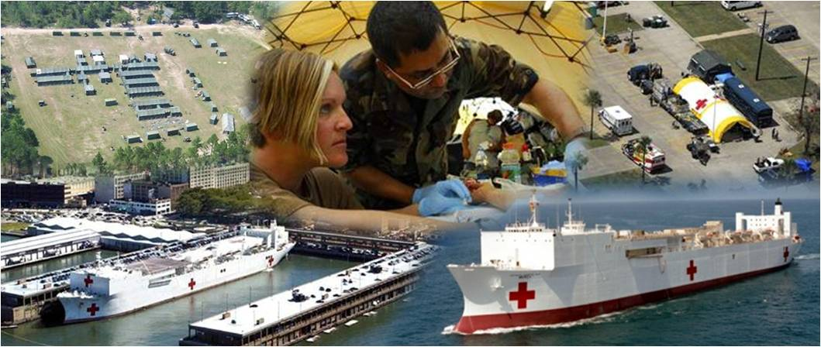
Medical Capabilities
Army Combat Support Hospital
Naval Ships Mercy and Comfort
Air Force SPEARR Team
Notes:
53

Slide 54
Special Capabilities
Explosive Ordnance Disposal (EOD)
Chemical, Biological, Radiological, Nuclear, or high yield Explosive (CBRNE) assets
Airborne capabilities
National Guard Weapons of Mass Destruction Civil Support Teams (WMD-CSTs)
Notes:
54

Slide 55
Incident Support Base (ISB)
Military may provide support at a military installation
Aerial port of debarkation
Staging area
Provide sheltering
Notes:
55

Slide 56
Possible Missions
Hurricane and tornado missions
Earthquake missions
Flood missions
Winter storm missions
Wildland fire missions
Notes:
56

Slide 57
Activity: Possible Missions Performed by Military Resources
Read Part I scenario and complete it
Read Part II scenario and complete it
Prepare a brief summary of your findings and share them with the class
Notes:
57

Slide 58
Lesson Summary
Active Duty resources:
Include five services branches and three auxiliaries to the military services
Are always under Federal command authority and under military command through their chain of command
May provide support during hurricanes, tornadoes, earthquakes, floods, and winter storms
May provide general, medical, and special support during emergencies
Are prohibited from enforcing civil law
Notes:
58

Slide 59
Questions?
Notes:
59

Slide 60
Lesson 3: Planning for Military Resources in Military Management

Slide 61
Topics Covered
The following topics are covered in this lesson:
National Incident Management System (NIMS)
National Response Framework (NRF)
Integration of Military Resources in Accordance with NIMS
and NRF
Building and Maintaining Key Relationships
Planning for a Maximum Disaster Incident
Developing a Military Support Emergency Support Function
Military Support ESF Development Team Members
Military Support ESF Development Process
Emergency Management Tools
Relationships
Notes:
61

Slide 62
Objectives
After completing this lesson, you will be able to:
Describe the process for developing a Military
Support Emergency Support Function (ESF) annex
for your jurisdiction
Describe the planning products resulting from the planning process
Notes:
62

Slide 63
National Incident Management System
Incidents typically begin and end locally
Sometimes successful incident management depends on multiple and various parties
Notes:
63

Slide 64
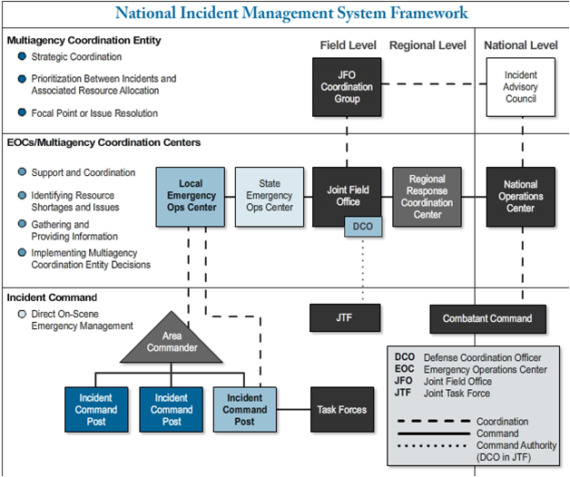
National Incident Management System (NIMS)
Notes:
64

Slide 65
National Response Framework (NRF)
Enables all response partners to prepare for and provide a unified national response to disasters
and emergencies
Establishes a comprehensive, national, all-hazards approach to domestic incident response
Defines the principles, roles, and structures that organize how we respond
Describes how response partners work together
Notes:
65

Slide 66
Integration of Military Resources in Accordance with NIMS and NRF
The DoD implements NRF policies and procedures:
As appropriate
Consistent with NIMS and the ICS
Notes:
66

Slide 67
Integration of Military Resources in Accordance with NIMS and NRF (continued)
President -> Secretary of Defense -> Commander -> Tactical Level Commander
“Supporting and supported” relationship between military forces and civilian incident commander
Notes:
67

Slide 68
True or False?
When responding to an emergency, Federal military forces always remain under command of the Incident Manager.
Notes:
68

Slide 69
True or False?
Federal military forces are subject to recall at any time.
Notes:
69

Slide 70
True or False?
For Federal military forces, command starts with the Secretary of Defense.
Notes:
70

Slide 71
Building and Maintaining Key Relationships
Success is based on emergency managers at all levels who build and maintain relationships as well as having capabilities to respond to major incidents
Notes:
71

Slide 72
Planning for a Maximum Disaster Incident
Determine hazards and threats that may cause impact
Determine jurisdiction’s response capabilities and limitations
Plan for the maximum credible disaster incident
Assess response resources’ capabilities and availability
Notes:
72

Slide 73
Developing a Military Support Emergency Support Function
Identify a credible disaster scenario that would overwhelm individual agencies
Identify and contact local, state, and/or Federal military planners and liaison officers
Provide situation reports as necessary
Notes:
73

Slide 74
Military Support ESF Development Team Members
Several primary and supporting agencies within
a local jurisdiction could play role in developing
the ESF
Notes:
74

Slide 75
Military Support ESF Development Team Members (continued)
Primary agency responsible for obtaining information and coordinating delivery of assistance
Most important step: assemble a team of subject matter experts to work together
Notes:
75

Slide 76
Emergency Management Tools
FEMA Comprehensive Preparedness Guide
(CPG 101)
ESF Worksheet
Lessons Learned Information Sharing (LLIS) Site
Notes:
76

Slide 77
Relationships
Best practice remains establishing relationships with military officials
Notes:
77

Slide 78
Lesson Summary
Incidents typically begin/end locally
Success based on emergency managers at all levels building and maintaining key relationships
Notes:
78

Slide 79
Course Summary
Lesson 1: Types of Military Response and Integration of Military Support
Lesson 2: Military Resources and Capabilities
Lesson 3: Planning for Military Resources in
Military Management
Notes:
79

Slide 80
Questions?
Notes:
80

